Slide 1

C Programming Project Presentation
Project Title: Mini Attendance Tracker
Course: C Programming Lab
Student Name & Roll No: Kathiravan -25BCS226, Kavina- 25BCS227, Kishore- 25BCS228, Kusuma- 25BCS229, Litheesh- 25BCS230
Department: Computer Science
Mentor / Guide: Moses John Prakash ,Assistant Prof,..

Slide 2
Introduction
C Programming Project Presentation
Overview of the Project and Its Purpose
The Mini Attendance Tracker is a simple console-based application designed to help teachers or class representatives efficiently record and manage student attendance during a session. The system allows users to set the class size, mark all students as present or absent, update attendance for individual roll numbers, and view summaries of present and absent students. Its purpose is to provide a quick and organized way to handle attendance data without needing manual paperwork.
Problem Background and Motivation
In many educational institutions, attendance is still tracked manually using registers or spreadsheets, which can be time-consuming and prone to human errors. Managing large class sizes becomes difficult, especially when attendance must be taken frequently. This project was motivated by the need for a lightweight, user-friendly, and efficient tool that can automate the attendance marking process within a single session, saving time and effort for both students and teachers.
Significance of the Project in Solving Real-World Issues
The Mini Attendance Tracker addresses common challenges in traditional attendance management systems. It ensures accuracy, speed, and simplicity, reducing the likelihood of missing or duplicate entries. By providing instant summaries and the ability to update records easily, it enhances classroom organization and productivity.

Slide 3
Objective
C Programming Project Presentation
Goal of this project:
The project aims to create a simple yet effective system that can record, update, and display student attendance automatically during a session.
To apply core programming logic and modular design
The project focuses on using key C programming concepts such as loops, arrays, functions, and conditional statements to build a structured and modular application.
To demonstrate problem-solving and analytical skills
Through designing and debugging the program, the project helps in enhancing logical thinking, algorithmic approach, and the ability to translate real-world problems into working code.

Slide 4
Problem Statement
C Programming Project Presentation
Manual attendance tracking is slow, repetitive, and error-prone.
This project aims to automate the process for small classroom sessions by providing a simple, console-based interface that:
> Records attendance efficiently.
> Ensures accuracy through validation.
> Displays quick summaries and lists.
> All without the need for external files or databases.

Slide 5
System Requirements
C Programming Project Presentation
Hardware Requirements
Processor: Intel Core i3 or higher
RAM: Minimum 4 GB
Storage: At least 500 MB of free disk space
Software Requirements
Operating System: Windows or Linux
Compiler: GCC / Turbo C / Code::Blocks / Dev C++
Editor: Visual Studio Code / Notepad++

Slide 6
System Design
C Programming Project Presentation
The Mini Attendance Tracker follows a modular and menu-driven architecture. Each user operation is handled by a dedicated function to improve clarity and maintainability.

Slide 7
1. Structure and Workflow of the System
Main Workflow
Start → Initialise all roll statuses to '-'.
Display Menu → Show user options (1–8).
User Input → Read and validate choice.
Process Choice:
Set Class Size → Define number of students (N).
Mark All → Record attendance for all rolls (P/A).
Update Roll → Change one student’s status.
Show Summary → Count present/absent & calculate percentage.
Show Present/Absent Lists → Display respective rolls.
Reset Session → Clear all statuses to '-'.
Exit → End program.
Repeat Menu until user selects Exit.

Slide 8
2. Flowchart (Logic Flow)
START
↓
Initialise status[]='-
↓
Display Main Menu (1–8)
↓
Read User Choice
↓
Perform Selected Action
(Set Size / Mark / etc.)
↓
Choice == 8 ? (Exit)
yes↓ no↓
Exit ← Show Menu

Slide 9
3. Algorithm Outline
Step 1: Start
Step 2: Display main menu
Step 3: Get user choice
Step 4: Uses switchcase,
If choice = 1 → Set/Change class size
If choice = 2 → Mark attendance (P/A) for all roll
If choice = 3 → Update one roll
If choice = 4 → Show summary
If choice = 5 → Show present list
If choice = 6 → Show absent list
If choice = 7 → Reset session
If choice = 8 → Exit
Step 5: Repeat until user selects Exit
Step 6: Stop

Slide 10
4. Block Diagram (System Modules)
1. Input Module
→ Accepts class size, roll updates
2. Processing Module
→ Marks attendance, updates records
3. Display Module
→ Shows summary, present & absent
4. Control Module
→ Handles menu navigation & choices

Slide 11
Module Description
C Programming Project Presentation
Input Module – Takes user input for class size, attendance (P/A), and roll updates. Performs validation to ensure correctness.
Processing Module – Handles logic for marking attendance, updating rolls, counting present/absent, and calculating percentage.
Output Module – Displays the attendance summary, present and absent lists, and confirmation messages to the user.
Control Module – Manages the main menu and coordinates function calls for each selected operation.

Slide 12
Algorithm / Flowchart
C Programming Project Presentation
Step 1: Start the program
Step 2: Initialise necessary variables and arrays for storing attendance data
Step 3: Display the main menu with available options
Step 4: Get user input (choice)
Step 5:
If choice = 1 → Set/Change class size
If choice = 2 → Mark all present
If choice = 3 → Update one roll number
If choice = 4 → Show summary
If choice = 5 → Show present list
If choice = 6 → Show absent list
If choice = 7 → Reset session
If choice = 8 → Exit
Step 6: Perform the selected operation
Step 7: Display the result or updated status to the user
Step 8: Repeat steps 3–7 until the user exits
Step 9: Stop the program

Slide 13
Flowchart
Start
│
Initialise Data
│
Get User Input
│
Process Data
│
Display Output
│
Stop

Slide 14
Implementation
C Programming Project Presentation
Techniques Used:
Loops and Conditional Statements – Used for menu repetition, roll marking, and decision-making (for, while, if-else, switch).
Functions – Each operation (set class size, mark all, update, summary, etc.) is written as a separate function.
Arrays – A 1D array status[MAX] is used to store attendance for each student.
Input Validation – Ensures only valid inputs (P, A, or valid roll numbers) are accepted.
Formatted Output – printf() , scanf() is used.

Slide 15
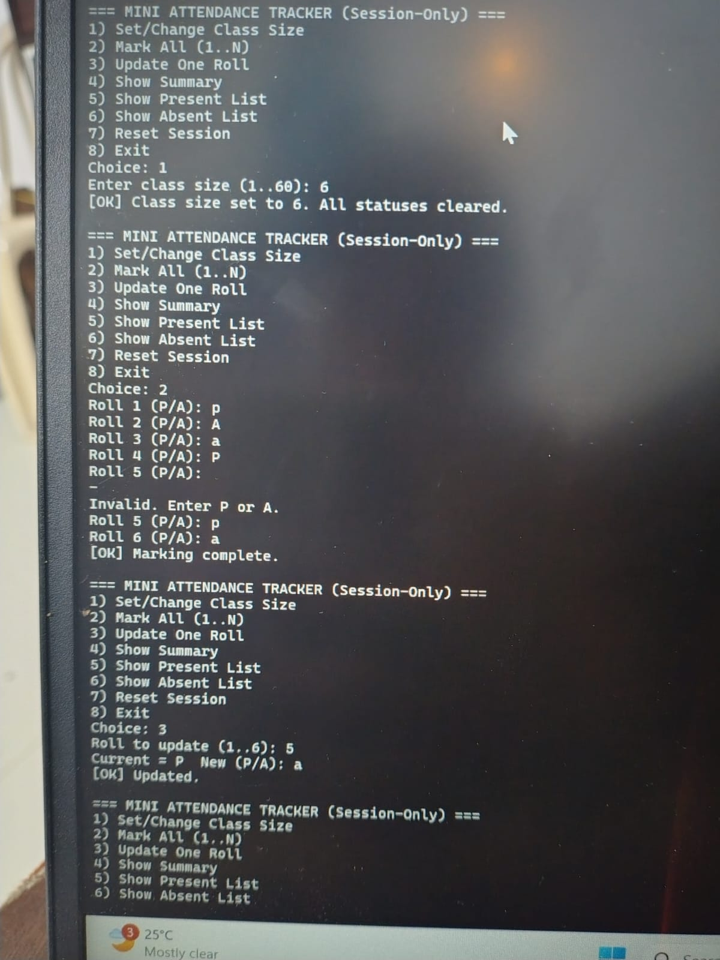
Input and output Screen
C Programming Project Presentation

Slide 16
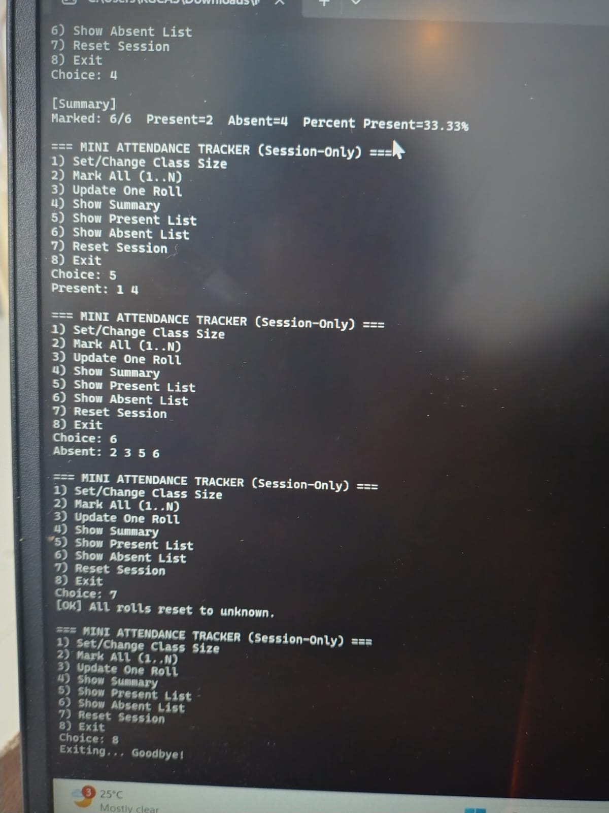
C Programming Project Presentation

Slide 17
Results & Discussion
C Programming Project Presentation
The Mini Attendance Tracker performed successfully according to the project objectives. The program accurately recorded and displayed attendance for any class size between 1 and 60 students. It efficiently generated summaries showing the number of students present, absent, and the overall attendance percentage.
The system’s outputs matched the expected results across various test cases — including all-present, all-absent, and mixed attendance scenarios. Input validation prevented crashes and ensured consistent accuracy. The use of arrays and functions contributed to fast execution and a clean, modular structure.
During implementation, challenges such as handling invalid inputs and ensuring correct percentage calculations for partially marked sessions were resolved using robust input validation and conditional logic. Overall, the project demonstrates a reliable, well-structured, and efficient application of core C programming concepts to a practical problem.

Slide 18
Conclusion & Future Enhancement
C Programming Project Presentation
Conclusion:
Project achieved its main goal of building a session-based attendance tracker. Strengthened understanding of C concepts, logic flow, and modular design .Demonstrated practical application of arrays, loops, and functions.
Future Enhancements:
GUI support for better interaction can be added, Integrate database for record storage, using extend features for scalability and automation can also be added for the better future.

Slide 19
References / Acknowledgement
C Programming Project Presentation
Reference
• Let Us C – Yashavant Kanetka
• C Programming – E. Balagurusamy
• Online resources and documentation
Acknowledgement:
I sincerely express my gratitude to my mentor for their valuable guidance and support. Special thanks to my department for providing resources and I also appreciate my team members for their cooperation and contribution throughout the project.

Slide 20
Thank You
Every roll counts — track it right, code it light!
Every roll counts — track it right, code it light!
Questions:
Why is an array used to store attendance instead of another data type?
What does toupper() do in this code?
What happens if the user enters a roll number outside the valid range?

